Slide 1


Rowan Atef ID:231001403
Samaa Awwad ID:231002236
Injy Hatem ID::231000596
Amira mommtaz ID: 231001071

Slide 2

Medical Laboratory System
A closer look for Laboratory Database system

Slide 3
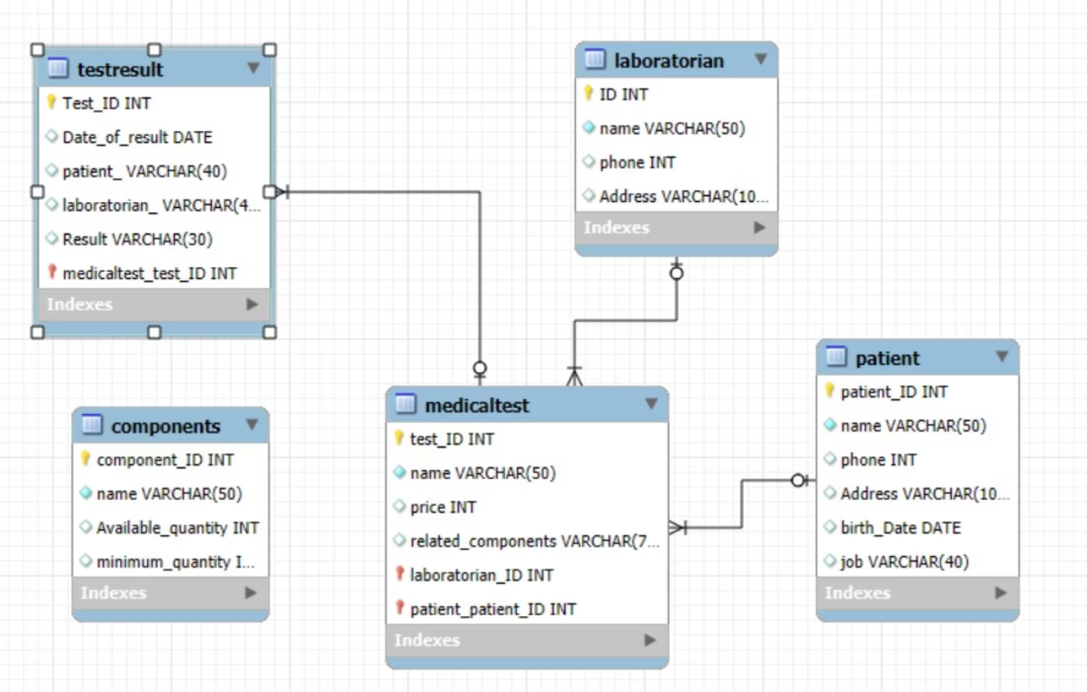
ER Model

Slide 4
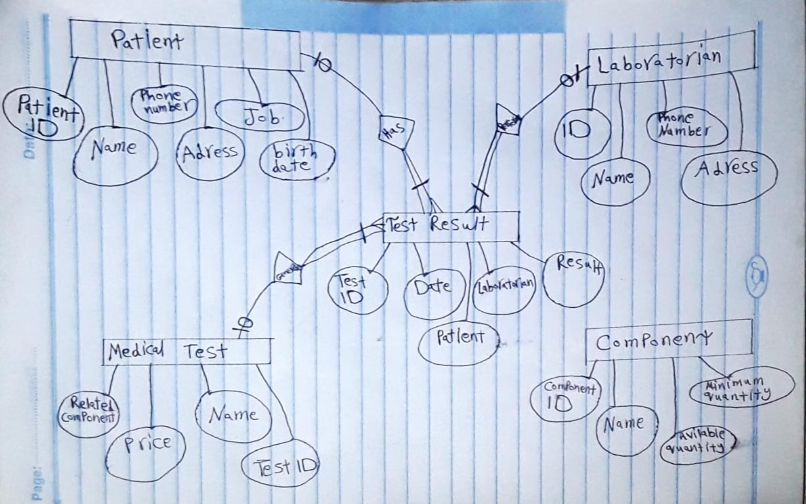
Core Entities and Attributes

Slide 5
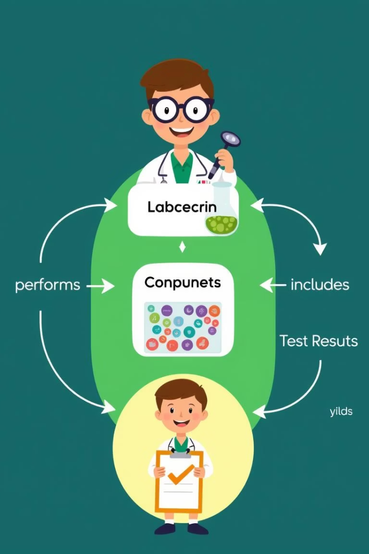
Relationships and Constraints
1
Laboratorian to TestResult
(one-to-many).
2
Patient to TestResult
(one-to-many).
3
MedicalTest to Component
Many-to-many relationship
4
Participation Constraints
Every test result must link to one patient, laboratorian, and medical test. Components may not be linked to any test.

Slide 6
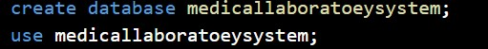
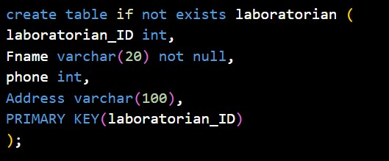
DDL Usage:

Slide 7

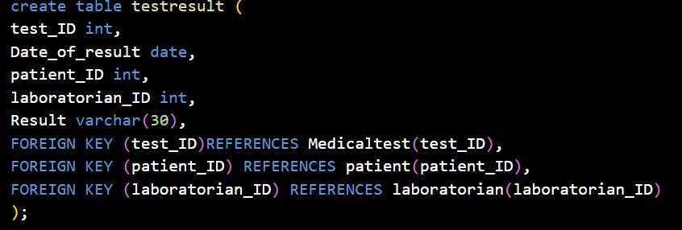
Database Schema: Tables and Keys

Slide 8
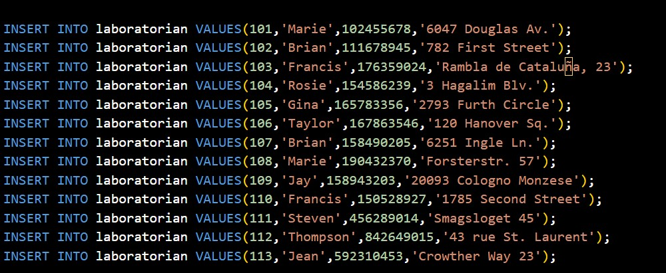
SQL Scripts: DDL and DML Examples
DDL Scripts
DML Queries
Sample queries for inserting, updating, and retrieving data from the MLS database.
Define tables, keys, and constraints to structure the database.

Slide 9
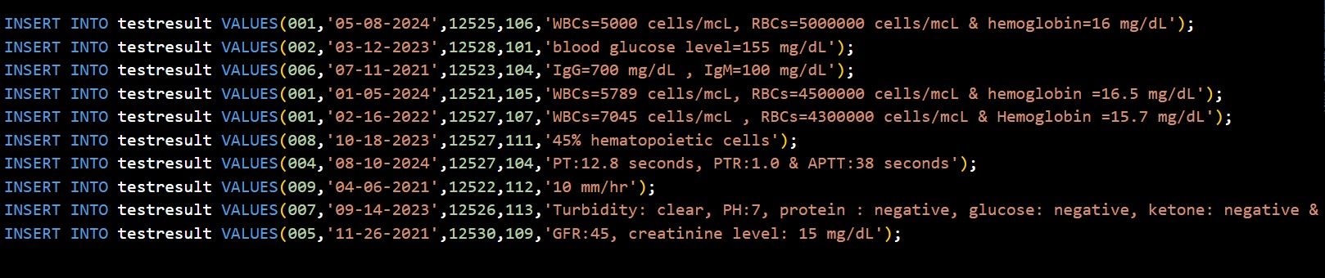
Example Data:

Slide 10
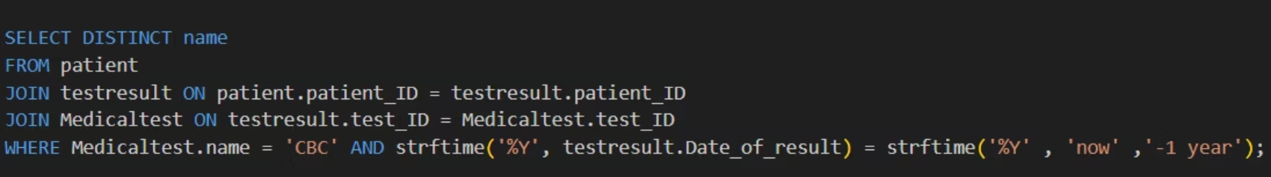
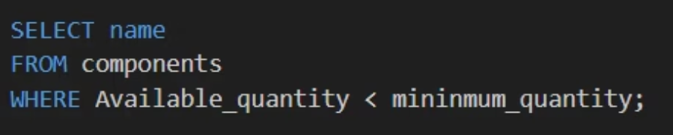
Sample of Data coding:

Slide 11
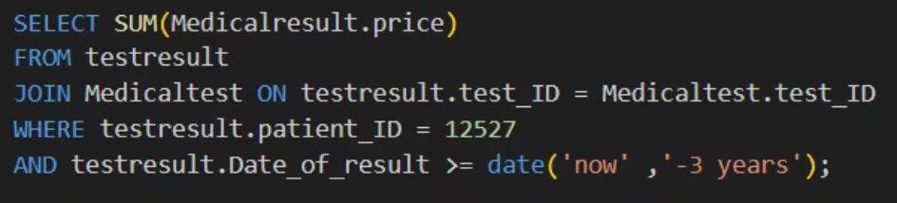
Sample of Data coding:

Slide 12
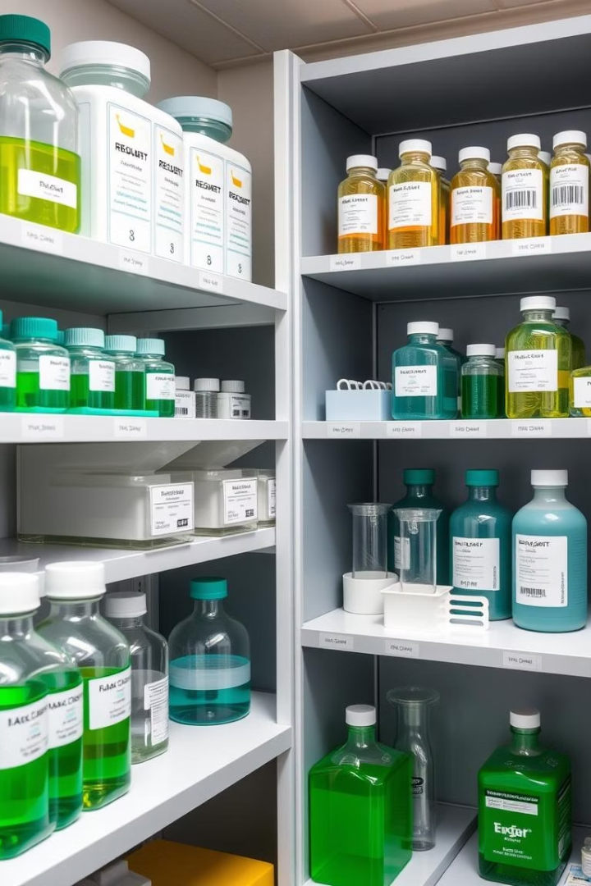
Test Components and Their Management
Component Tracking
Monitors available quantity and minimum stock levels to trigger restocking.
Usage in Tests
Components are linked to multiple medical tests, ensuring proper resource allocation.

Slide 13

System Benefits and Efficiency
Improved Test Tracking
Data Accuracy
Ensures relational integrity through strict database constraints.
Streamlines recording and retrieval of test results for patients.
Decision Support
Advanced queries enable informed business and clinical decisions.

Slide 14

Thank you…

